Slide 1
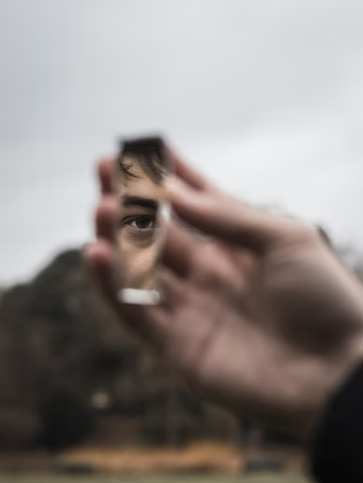
Just Like Me
What kind of church would it be if everyone in it was just like me?
Notes:
The Lord uses diversity in the body of Christ; we are one body but many different members. Yet, because we are all striving to be like Christ, there are core similarities between us. The apostle Paul encouraged others to imitate him as he imitated Christ. If we are being transformed, shouldn’t we able to encourage others to imitate us?

Slide 2
Diversity in the Body of Christ
Everyone is different – has different gifts, different abilities, different roles to fill (Romans 12:4-8).
Yet, Christians are to be similar in many respects (1 Corinthians 1:10).
Similarity is to be expected since we are all being transformed into the same image (2 Corinthians 3:18).

Slide 3
The Challenge to be an Example
Could we, as Paul did, offer ourselves as a pattern for others to follow (1 Cor. 4:16; 11:1)?
Do we all not have the responsibility to live an exemplary life (Phil. 3:17; 1 Tim. 4:12)?

Slide 4
Paul would have us Live as he Lived
In purity of life (Philippians 4:8-9).
In patient persistence (Philippians 3:12-16).
In priorities (Philippians 3:17-20; Colossians 3:1-2).

Slide 5
Paul would have us Preach as he Preached
Motive (Philippians 1:15-18)
Manner (Acts 14:3; Ephesians 6:18-20)
Message – the gospel (Romans 1:16; Galatians 1:8)

Slide 6
Paul would have us Become what he Became
“I would to God that not only you, but also all who hear me today, might become both almost and altogether such as I am, except for these chains” (Acts 26:27-29).
You can only say such things, if you can say this: “I have been crucified with Christ; it is no longer I who live, but Christ lives in me; and the life which I now live in the flesh I live by faith in the Son of God, who loved me and gave Himself for me” (Galatians 2:20).

